Slide 1
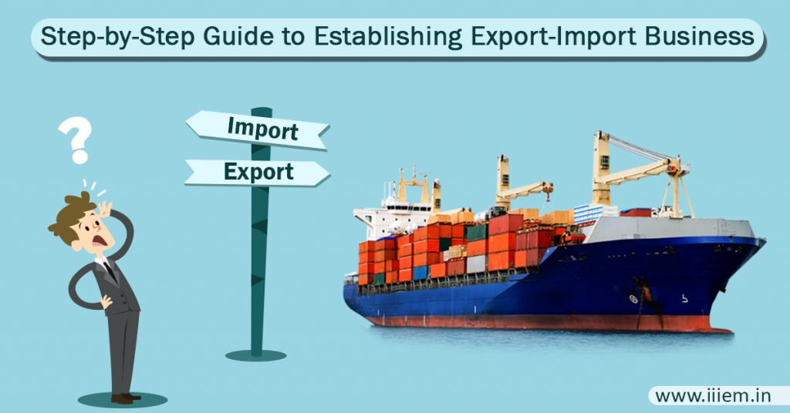

Slide 2
IMPORT EXPORT PROCEDURE
India is one of the major hubs for exporting particular items in the world. The state of Gujarat independently shares 25% of the total Indian export market. The International exhibitions that are held in the different parts of India are one of the most helpful events for the established Indian brands to enhance their export share..

Slide 4
EXPORT CYCLE FOR THE ENTREPRENEURS
1: Receipt of an Inquiry from the Buyer
The exporter receives an inquiry from the buyer for the purchase of a particular product of his brand. You have to check the creditworthiness of the buyer by contacting the Indian export councils. This will help you to deal with genuine buyers.
2: Sending Quotation to the Importer
As an exporter, you have to send the price of the demanded goods to the importer. Many times the importer also asks for a free sample to check the quality; so the exporter also has to send a free sample for the verification of quality.

Slide 5
3: Product Approval & Purchase Order
Once the importer approves the quality of the sample, you will get a purchase order describing the complete order details. You must read the purchase order carefully for moving further with the payment terms.
4: Payment terms & Negotiation
This is an important import export process that involves the final deal between the buyer and the supplier. Looking at the purchase order and the demands of the importer; you can decide upon the fair price of the products that are exported. Deciding upon the incoterms helps with reducing all the miscommunication and ends up with a successful export import procedure.

Slide 6
5: Hire CHA for container booking
An exporter will require a CHA for the export clearance of the goods from the domestic port destination. The exporter has to pay the freight charges to the CHA for the container booking. The CHA will send the empty containers to the exporter’s warehouse. The CHA will further generate a shipping bill with a successful customs clearance process.
This entire procedure will help your goods to receive the ‘port of loading’ for dispatching the goods to the importer’s country. The exporter will receive a bill of lading document for getting incentives or any other privileges from the government. Also, you have to send one copy of the bill of lading to the importer along with the set of year documents.

Slide 7
THANK YOU

